Slide 1
Customer Demonstration
SECURE, FAST, MANAGED ACCESS

Slide 2
WHAT IS DRIVESHARE?
Driveshare is a managed file sync and share tool that focuses on local file server cloud-enablement.
The multi-tenant easy to manage platform can either be used for:
mobile file server access without data replication
or
to replicate file server data and permissions
to cloud storage

Slide 3
COMMON CLIENT USE CASES
Self-Hosted Private Cloud Environment for Storage Data
File Server Access Portal
File Server Migration
Business Continuity
Cloud Backup
0365 Integration
Dropbox Replacement

Slide 4
Demonstration Overview
Product infrastructure
Architectural & Deployment Overview
Client User Experience
Windows Client, Web Browser &
Mobile Client
Admin Settings & Controls
Reporting & auditing modules

Slide 5
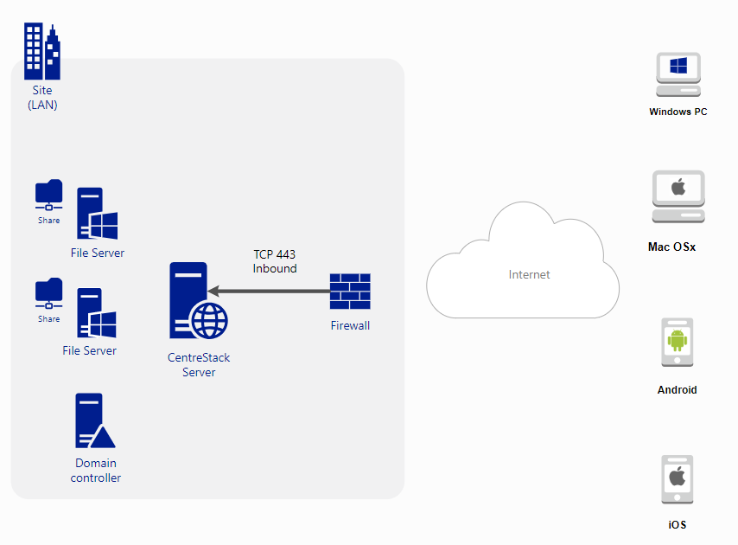
Architectural & Deployment Overview: Direct Access Deployment
Feature Highlights:
Direct access to hosted file servers
Native NTFS integration
Sync on-demand
Cloud enabled file server with no replication
Combines security compliance controls with Dropbox-like features
Primary Alternative to:
VPN, Remote Desktop Services (RDP)
Notes:
Direct Access Deployment
3 tier architecture with CentreStack between two firewalls
Data remains on the existing file server
Client presents AD creds over HTTPS (TCP 443)
CentreStack gets token from Active Directory domain controller
CentreStack impersonates user to access file shares using token
Shares presented on Clients device

Slide 6
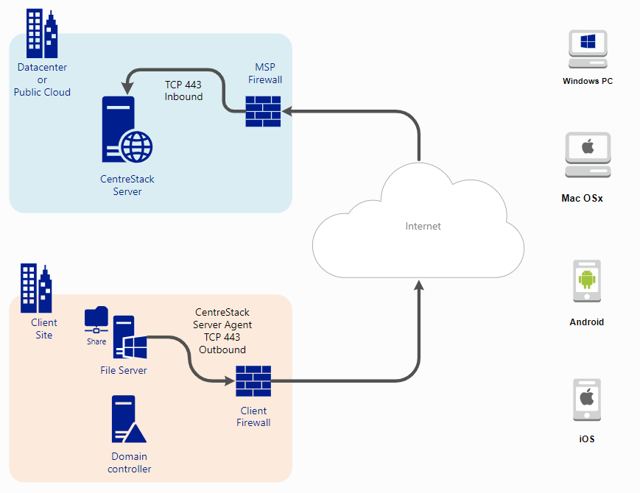
Architectural & Deployment Overview: Hybrid Deployment
Feature Highlights:
Also syncs AD users and NTFS permissions
Provides multi-tenant cloud-based file server that supports business continuity, disaster recovery and file server migration
Primary Alternative to:
Anchor, Autotask
Notes:
Direct Access Deployment
3 tier architecture with CentreStack between two firewalls
Data remains on the existing file server
Client presents AD creds over HTTPS (TCP 443)
CentreStack gets token from Active Directory domain controller
CentreStack impersonates user to access file shares using token
Shares presented on Clients device

Slide 7
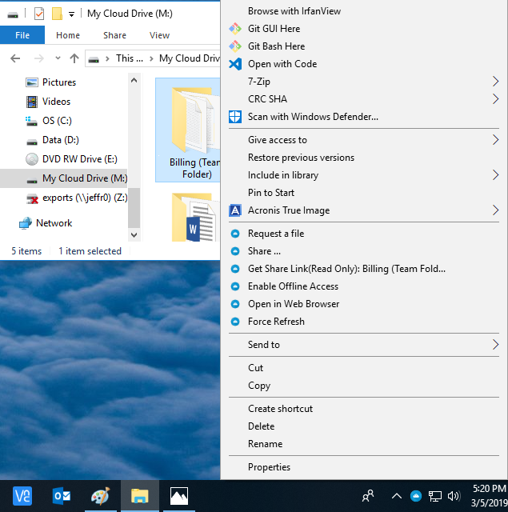
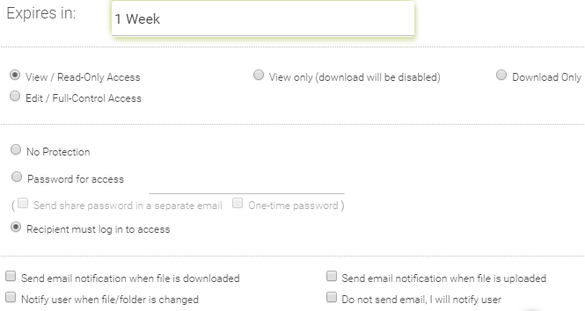
Windows Client File Access
Our Windows & Mac Client create a mapped drive on the desktop that works exactly like your C: drive in order to automatically save, share & sync files to the cloud, from the cloud and across multiple devices SEAMLESSLY in real time.
Sync & Share Permissions:
Right clicking on any folder or file gives the end user additional collaboration features with advanced access control settings.
Consistent User Experience:
Across all agents with offline access capabilities.
Notes:
Windows Client Device Features:
- Natively Mapped Drive
- Seamless User Experience
- File Locking & Contention
- Sharing & Centralized Administration
- Windows to Cloud Marriage

Slide 8
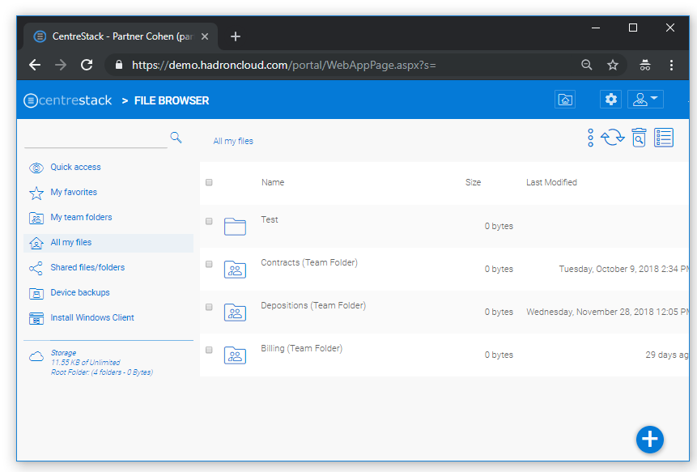
Web Browser File Access
Consistent User Experience:
between mobile and web browser with offline access capabilities.

Slide 9
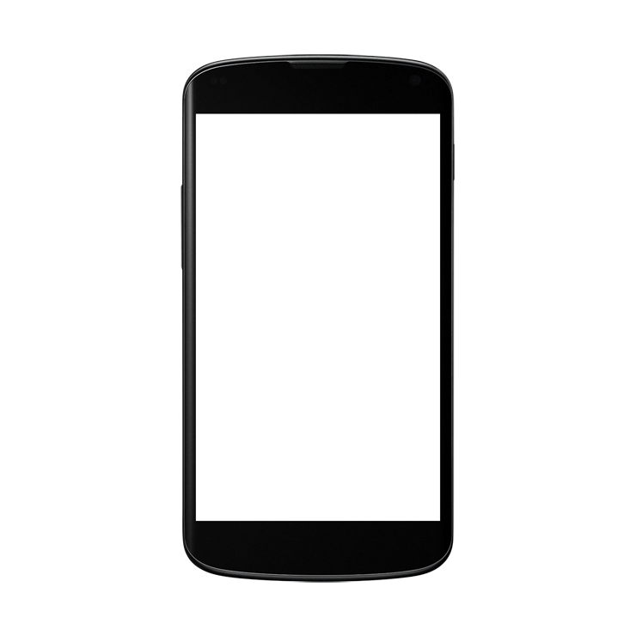
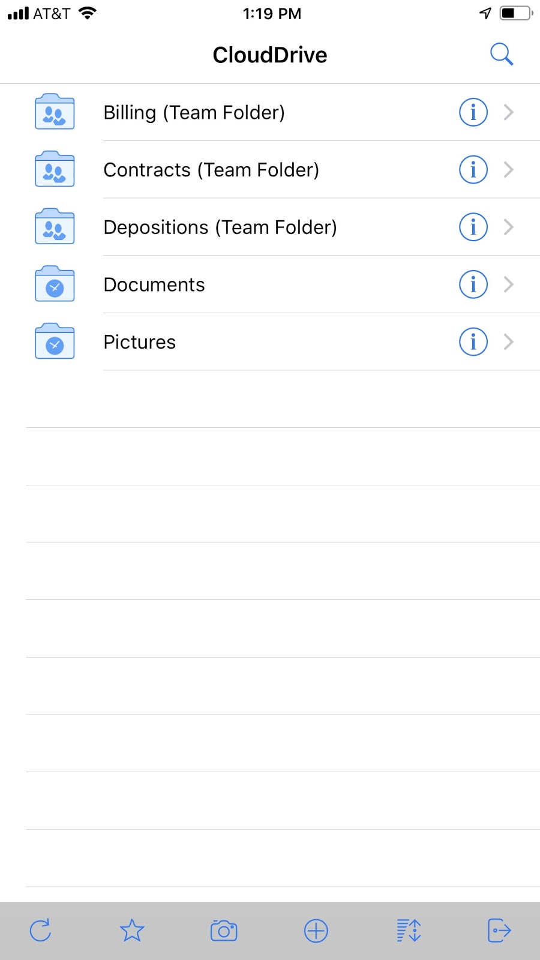
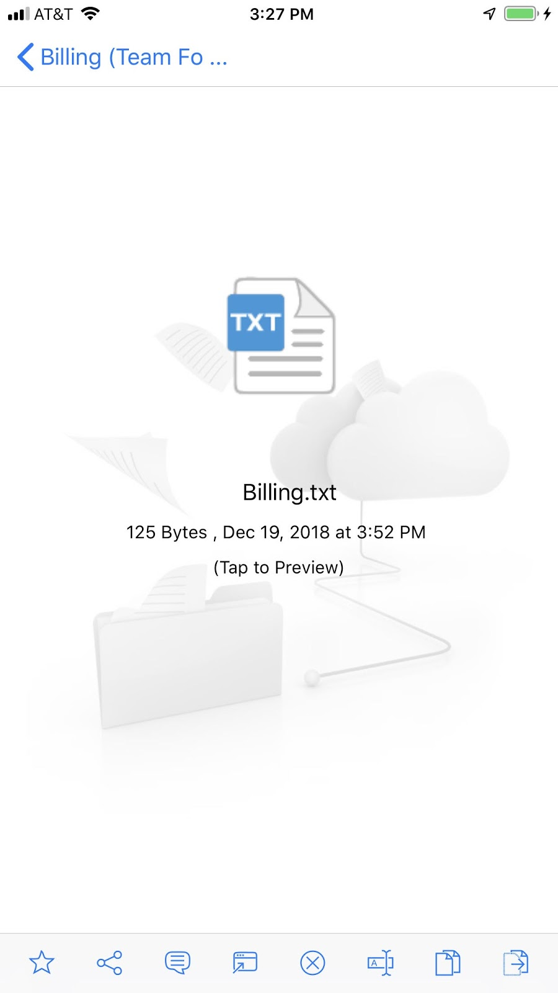
Mobile Device
Consistent User Experience:
between drive and web browser.

Slide 10
Administrator Management Scope
Choose how to host your or your client's data:
CentreStack
Hosted:
Sync4share URL
Self-Hosted:
Single Tenant Multi- Tenant
Notes:
Direct Access Deployment
3 tier architecture with CentreStack between two firewalls
Data remains on the existing file server
Client presents AD creds over HTTPS (TCP 443)
CentreStack gets token from Active Directory domain controller
CentreStack impersonates user to access file shares using token
Shares presented on Clients device

Slide 11
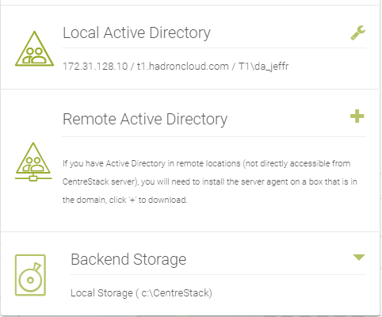
Deployment Examples
Objectives:
Security & Control, No Replication
Team Folder Locations:
Local vs Remote Network etc...
Backend Storage Location:
Local
Direct Deployment Example:
Comfort Medical

Slide 12
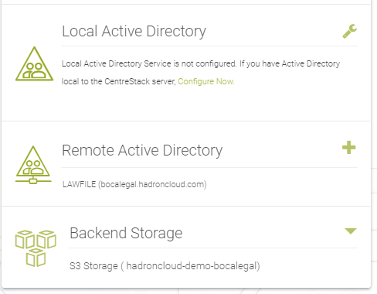
Deployment Examples
Objectives:
Security & Control, Private Cloud
Team Folder Locations:
Remote Network vs local etc...
Backend Storage Location:
Cloud
Hybrid Deployment Example:
Boca Legal

Slide 13
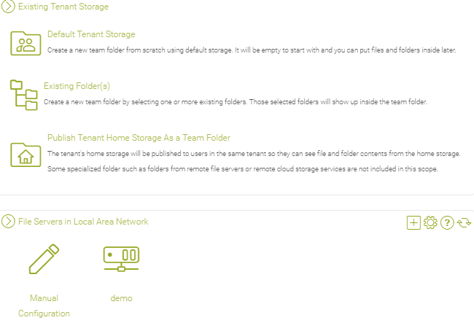
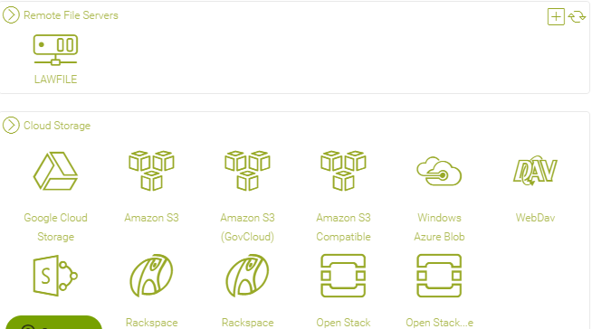
Team Folders
Migrate existing mapped folders and permissions from:
- Existing Servers
- LAN Servers
- Remote Servers
- Cloud Servers

Slide 14
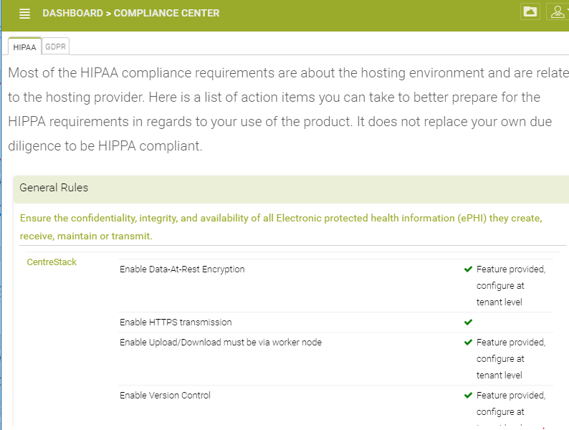
Compliance Center
HIPPA
SETTINGS

Slide 15
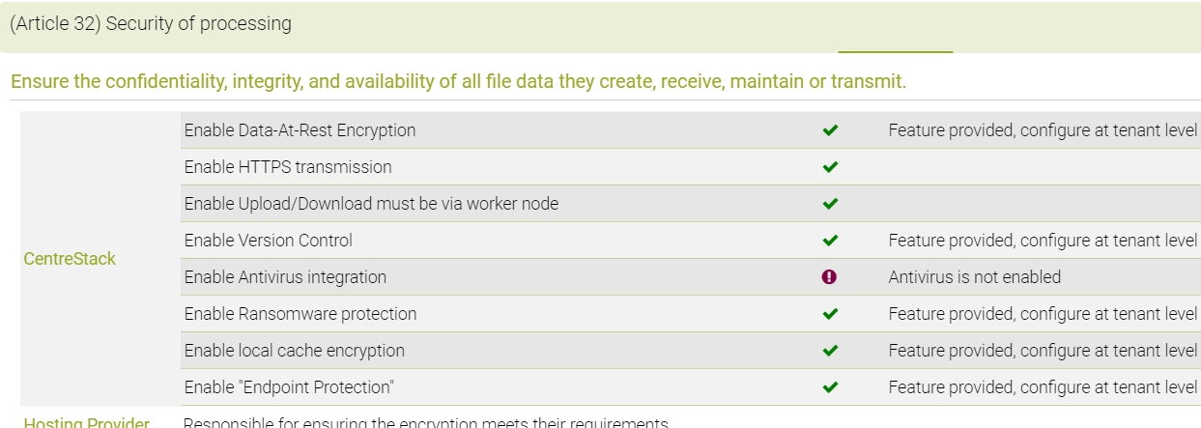
Compliance Center
GDPR
SETTINGS
Article 25: Data Protection By Design
Article 32: Security of Processing

Slide 16
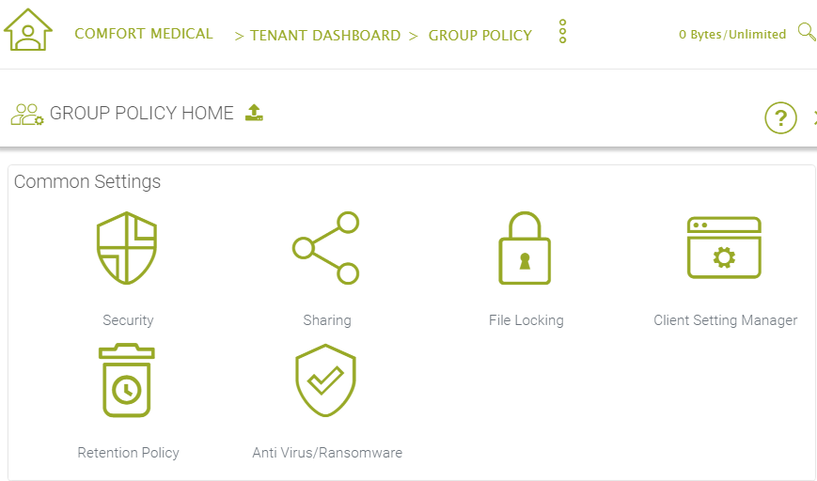
Group Policy
Settings
Group policy Highlights:
Sharing Permissions
Anti Virus/Ransomware
Client Setting Manager
Retention Policies
And more!

Slide 17
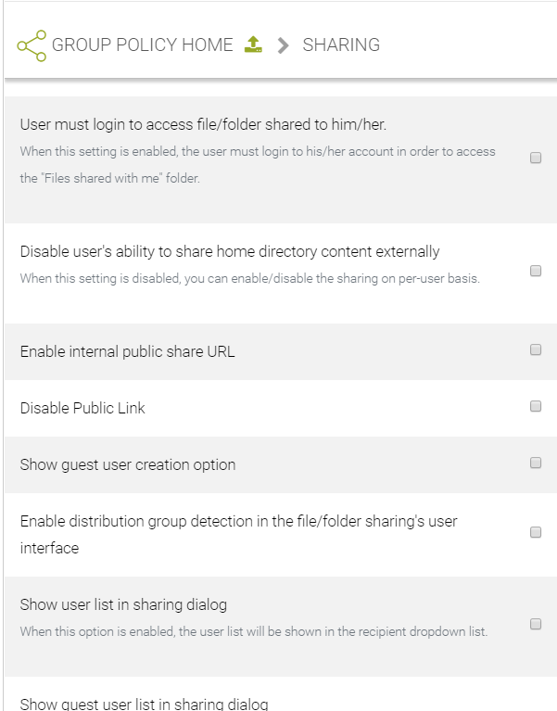
Group Policy
Settings
Disable Folder Sharing
Enable password protection
Expiration Time for Shared Files
Only allow sharing to specific domains
Default Outlook Plugin: auto-sync attachments to specific folder
And more!
SHARING

Slide 18
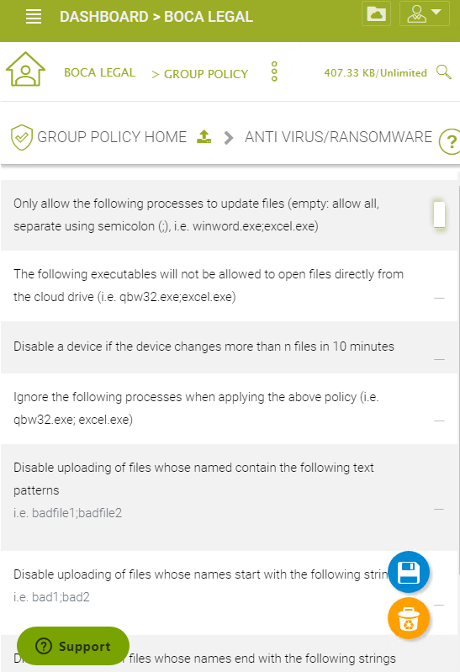
Group Policy
Settings
FEATURE HIGHLIGHTS
Behavioral heuristic that disables device access to network if it detects suspicious activity
ANTI-VIRUS / RANSOMEWARE DETECTION

Slide 19
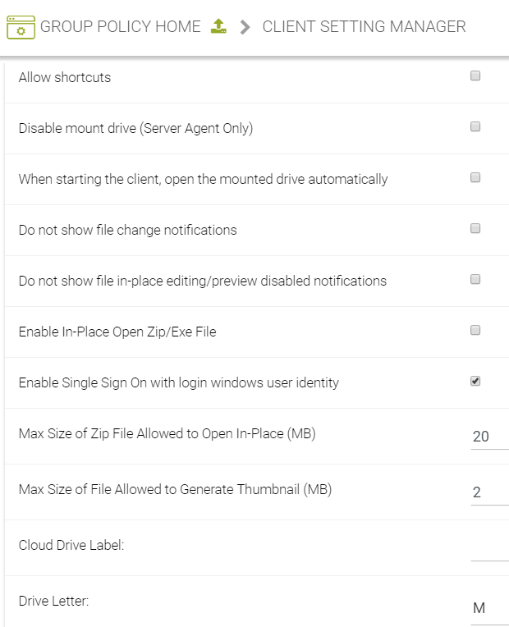
Group Policy
Settings
Feature Highlights:
Endpoint backup & protection
Encrypt local cache
Mapped drive settings
CLIENT SETTINGS MANAGER

Slide 20
Reports Module
If a law firm sent over a disposition to another law firm:
Audit trace log will show who sent the file to another law firm and when that file was sent.
AUDIT TRACE

Slide 21
Reports Module
If a Client loses a file and says they can’t find it anymore:
File Logging can show by action which files were deleted and when.
FILE CHANGE
LOGGING

Slide 22
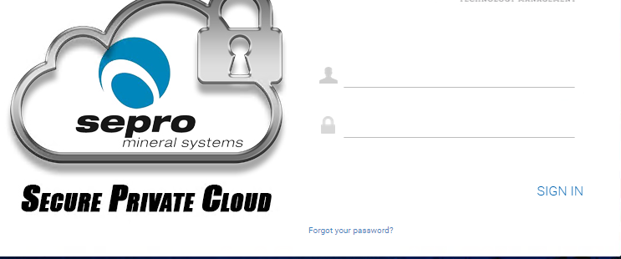
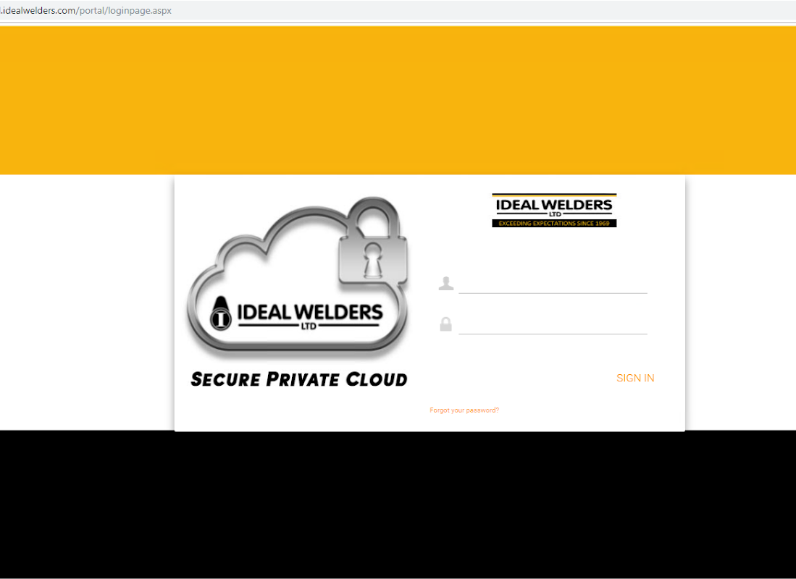
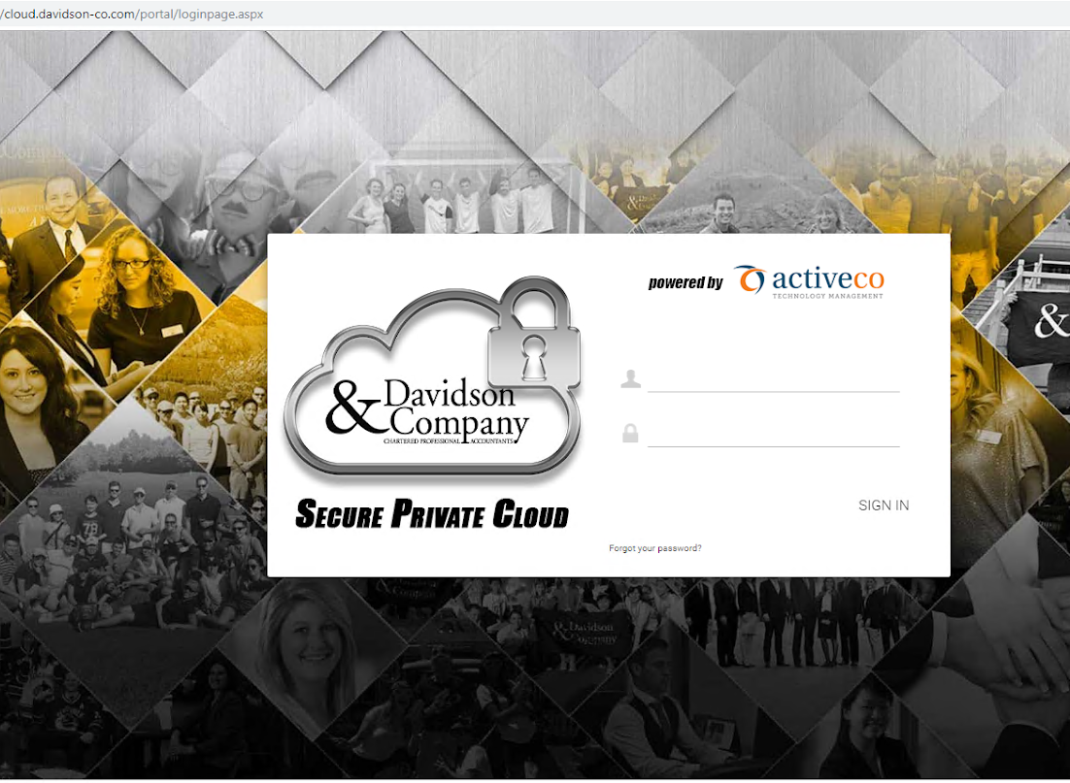
Branding Driveshare
CUSTOMIZE YOUR DRIVESHARE PLATFORM
Do it Yourself Branding:
Use the management console to rebrand the web interfaces, desktop clients & mobile clients with your own logos and images at no extra cost.
Customization:
The platform can be further customized to meet your needs.
Notes:
Direct Access Deployment
3 tier architecture with CentreStack between two firewalls
Data remains on the existing file server
Client presents AD creds over HTTPS (TCP 443)
CentreStack gets token from Active Directory domain controller
CentreStack impersonates user to access file shares using token
Shares presented on Clients device

Slide 23
Thank you For Choosing
+31 (0)85 1305 770
Leigraafseweg 21a
6983 BR Doesburg
support@Driveshare.nl

